Slide 1
Albert O. Hirschman
The Strategy of Economic Development

Slide 2
Background of Balanced Growth
Perceived Stumbling blocks in Lewis Model
  Where does the demand come from?
  Any worker hired in a new factory will not spend all of their income on the new product. Hence, a tendency toward too little demand
  Nurkse’s solution: Balanced growth combined with big push

Slide 3
Hirschman: a Different binding constraint
Decision-making capability
He was experiencing life in Latin America where incomes were not low and savings not binding constraint; capital flight
This suggests a new strategy of development

Slide 4
Argues against balanced growth
Balanced growth would only be feasible at tiny levels of new investment, but thereby losing the ability to take advantage of scale economies
It requires in large quantities what LDCs lack: decision-making capability
May involve too much government in planning and coordinating activities. Learning benefits leak out to foreign contractors
Unbalanced growth of a certain type both more feasible and optimal

Slide 5
Unbalanced Growth
A Disequilibrium Approach that puts pressure on investment decisions
This will be more innovative than an equilibrium among existing firms where none will want to do things that make others redundant.
It leads to induced investment. Investments induced by both market and non-market reactions.
Take advantage of external economic effects nay of which arise from technical complementarities either in production or use: Pecuniary and non-pecuniary external economies

Slide 6
Investment criteria vs Efficient Sequences
Since virtually every kind of investment is needed, investment criteria not likely to be of much importance
But sequencing may be important: In doing this between projects A and B, need to be concerned with whether A induces B more or less than B induces A

Slide 7
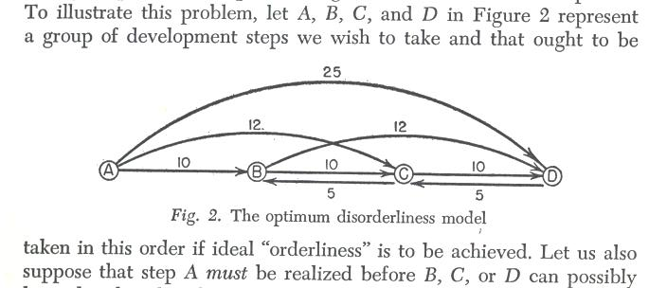
Sequencing

Slide 8
In absence of limiting factors sequence ABCD provides smoothest transition from state A to ABCD
But once D is achieved it may be very cheap to fill in B,C
So expenditure of scarce resources might be like the following table

Slide 9
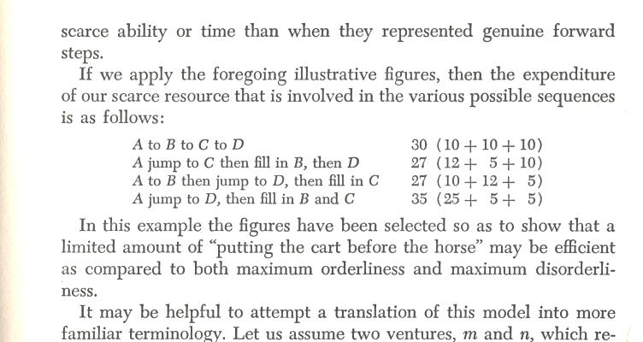

Slide 10
A more complex and realistic model would be to consider development as putting together a jigsaw puzzle. Put pieces in place so as to minimize the time to complete the puzzle
Strategy of getting max number of neighbors in place

Slide 11
Means of optimizing the sequence
Directly productive activities instead of Social overhead capital
Imbalance between DPA and SOC
Excess SOC is permissive. Whereas shortage compels . Hence SOC shortage may be a more efficient strategy. It also avoids waste of SOC in the wrong sectors, regions

Slide 12
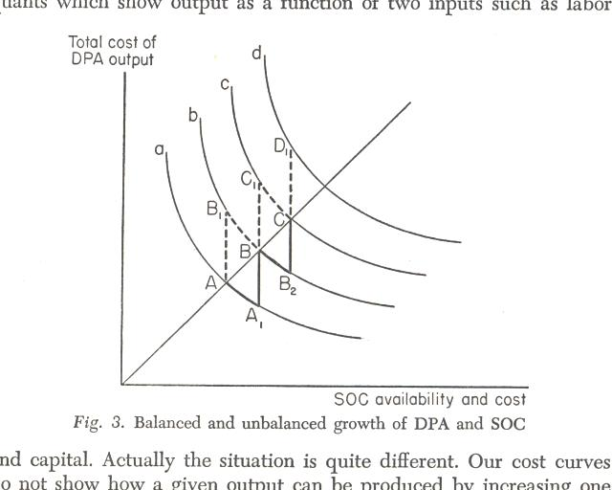

Slide 13
Compare costs of sequences
AA1BB2C
AB1BC1CD1
Where curve a represents costs of producing a given full capacity amount of DPA from given DPA investment and the differing amounts of SOC available
Objective to get increasing DPA at minimum cost in terms of both DPA and SOC. Shortage of decision making capability will favor the sequence that forces the decisions to be made most quickly

Slide 14
Linkages
Backward linkages Σ_{i}a_{ij} Direct and Indirect
Forward linkages Σ_{j}X_{ij} / Z_{i} where Z_{i} is total demand for i

Slide 15
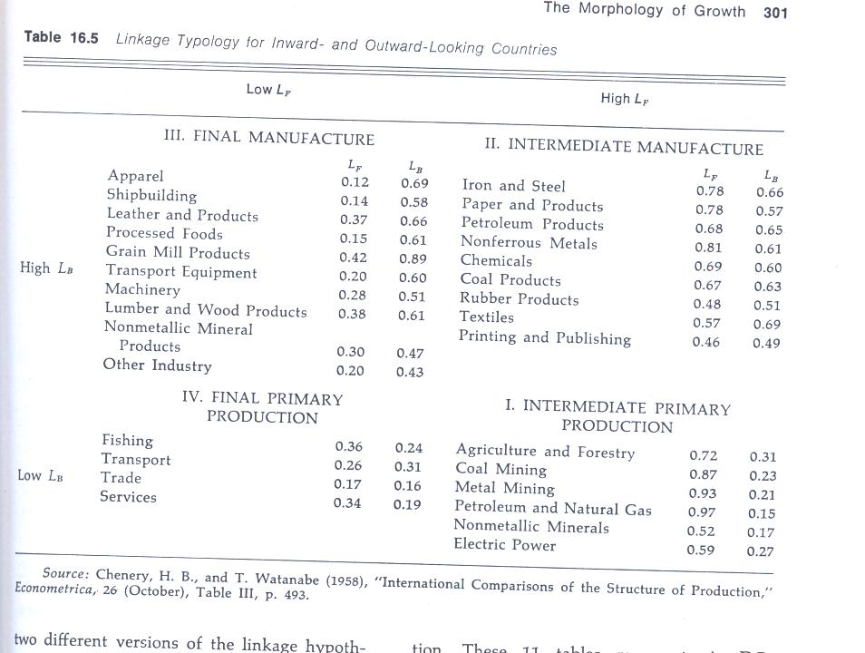
Operationalizing Linkages

Slide 16
Tests of Hirschmanian linkage hypotheses
Would countries with structures biased toward Linkage weighted sectors grow faster than those without this bias?
Yotopoulos and Nugent QJE 1973

Slide 17
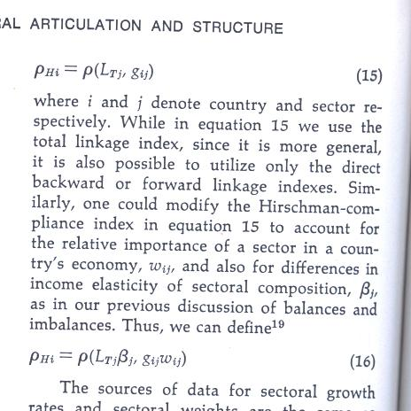
Measurement

Slide 18
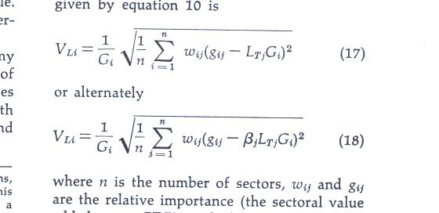

Slide 19
Conclusion of YN Test
Hirschman compliance indexes are not positive and significant
But measures of Hirschman imbalance are negative and significantly correlated supporting the hypothesis in its balanced version

Slide 20
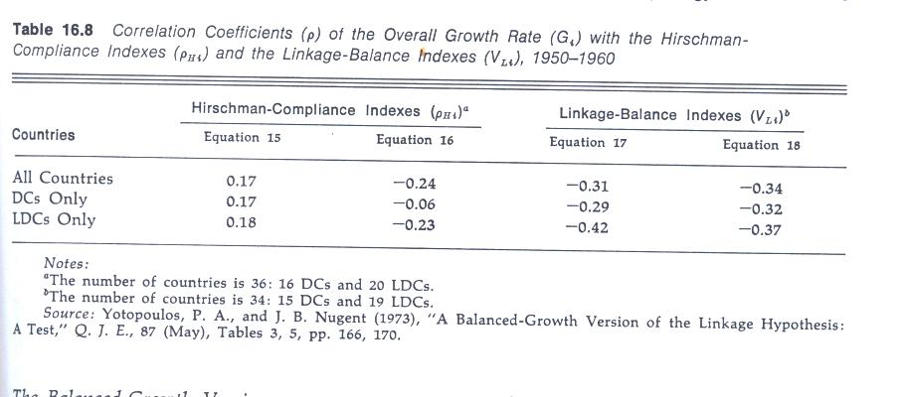

Slide 21
Back to Hirschman
Importance of maintenance activities
Air transport vs road and railroad transport
Capital intensity: efficiency of machine paced activities.

Slide 22
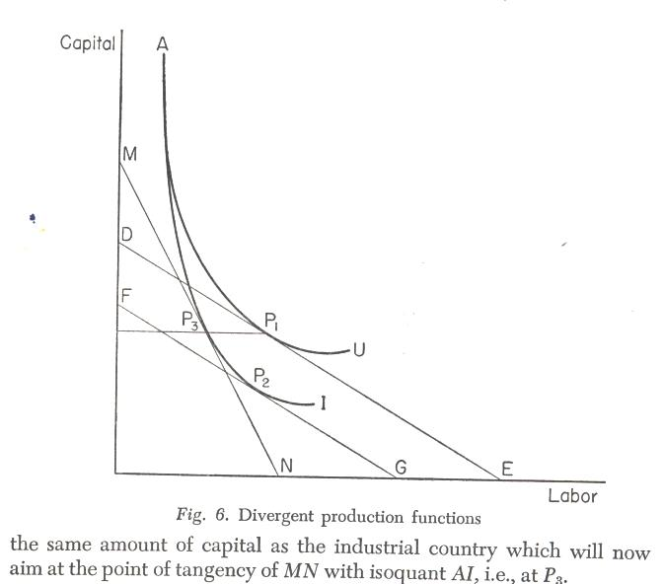
AU is MRS for Underdeveloped countries. AI is MRS for Industrial Countries
Hence in U countries it is optimal to use more capital relative to labor even if price of labor is much lower

Slide 23
Search for Key sectors
Industry
HDI in Korea
High-tech
High value added
Different kinds of linkage
  Employment
  Government revenue

